Slide 1
Databases
Lecture 2
Structured SQL Query Language

Slide 2
What we know
Data is stored according to predefined rules (data schema)
Working with data according to predefined rules
Relational data model:
A logical data model that does not depend on physical structures
Based on mathematics and logic
Relational Algebra

Slide 3
STRUCTURED QUERY LANGUAGE (SQL)
Domain-specific language (Domain-specific language)
Used to work with relational databases
Managing a large amount of information with a single request
No need to specify how we get the record

Slide 4
History
Donald Chamberlin and Ray Boyce, IBM:
Square: (Specifying Queries As Relational Expressions)
SEQUEL (Structured English QUEry Language), 1973-1974
Pat Selinger – cost-based optimizer
Raymond Laurie – query compiler
Later SEQUEL -> SQL
University of California Berkeley:
QUEL – could not stand the competition with SQL

Slide 5
SQL language standard
Background:
Different software from different manufacturers
Native query language implementation
Wanted to get:
Software portability
Received:
Partial portability

Slide 6
SQL language standard
1986 | The first attempt at formalization
1989 | SQL-86 + integrity constraint
1992 | A lot of changes
1999 | Regular expression matching, recursive queries, triggers, support for procedural and control operations, non-scalar types and object- oriented features.
2003 | Support for SQL implementation in Java and vice versa
2006 | XML-related functions, window functions, standardized sequences, and columns with automatically generated values
2008 | The way SQL works with XML is defined: ways of importing and storing, publishing XML and regular data in XML format
2011 | TRUNCATE, INSTEAD OF triggers. Improved window functions
2016 | Adds string pattern matching, polymorphic table functions, JSON

Slide 7
Standards issues
Core-section of the standard (introduced in 1992)
Manufacturers ensure compliance with Core only
Implementation differences
Syntax differences
Differences in logic

Slide 8
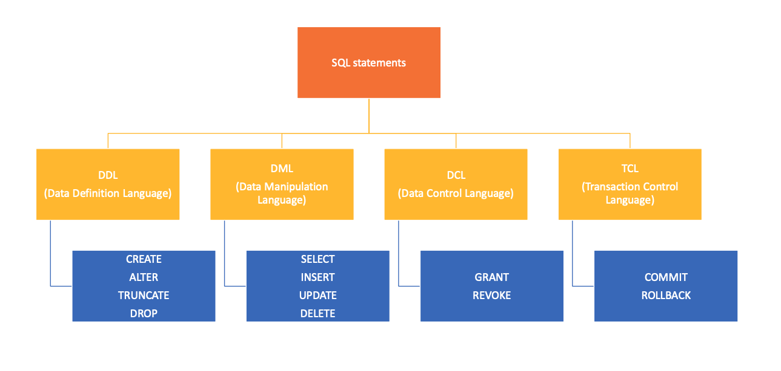
SQL Statements

Slide 9
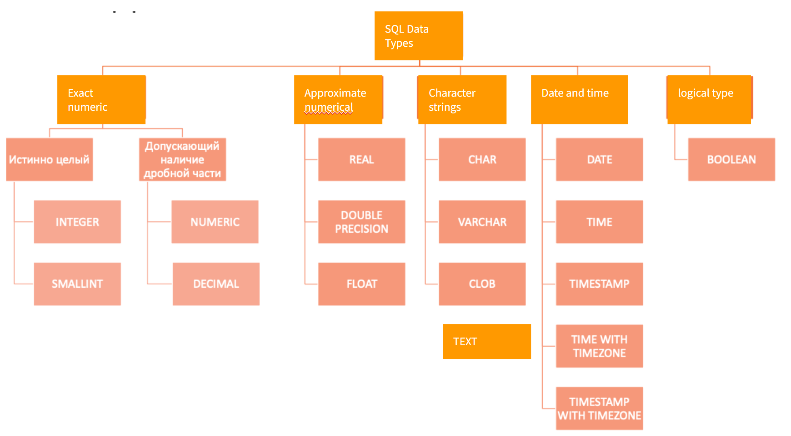
SQL Data Types

Slide 10
SQL program structure
Program is a sequence of commands
Command is a sequence of components. Command ends with ;
Components are key words, identificators, operators, strings, special symbols.
Components are separated by space symbols.
Each command has its own syntax.

Slide 11
Comments
CREATE TABLE lecturers (
id integer, --comment #1
name text, --comment #2
/* Multiline
comments
*/
birth_date date DEFAULT now() );

Slide 12
Data Definition Language
CREATE
Database object creation operation
ALTER
Database Object Modification Operator
DROP
Database Object Deletion operator
TRUNCATE
Operator for deleting the contents of a DB object

Slide 13
Data Definition Language
CREATE
CREATE [TEMPORARY] TABLE [IF NOT EXISTS] tbl_name(
col_name_1 datatype_1,
col_name_2 datatype_2,
...
col_name_N datatype_N
);

Slide 14
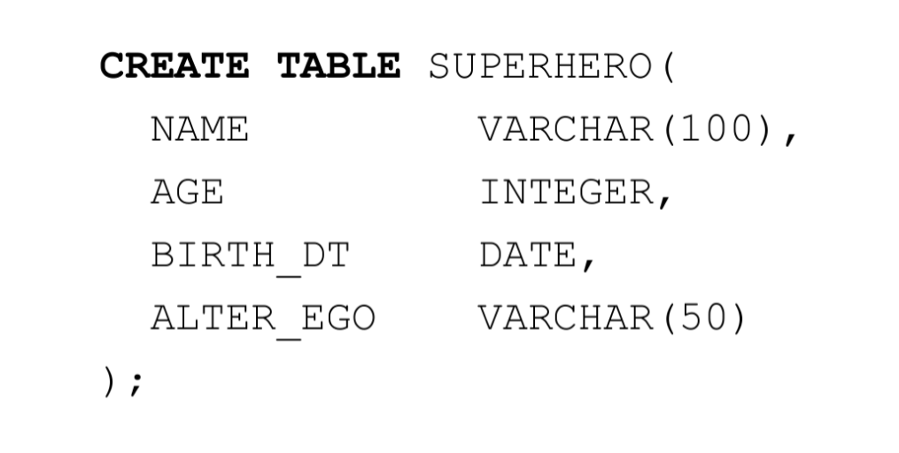
Create

Slide 15

Create

Slide 16
Create: restrictions
column name
CREATE TABLE students (
student_id int PRIMARY KEY,
first_name varchar(50),
last_name varchar(50),
age int NOT NULL,
email varchar(100)
);
column type
restriction

Slide 17
Restrictions
Serve as a means of maintaining data integrity
They guarantee that when entering data into the table, the relationships between the data will not be broken
Ensure referential integrity between tables (relationships) - through foreign keys
The constraint is specified after the data type or as a separate “statement” when defining the table

Slide 18
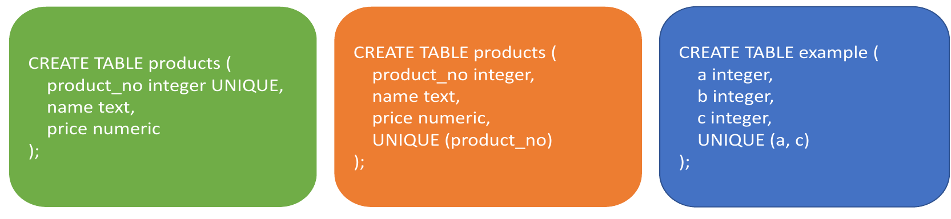
Restrictions: UNIQUE
UNIQUE - a group of one or more table columns can only contain unique values:

Slide 19
NULL value
A field with a NULL value is a field with no value.
If a field in a table is not required, then you can insert a new record or update without adding a value to the field; it will be stored as NULL.
A NULL value is different from a null value (0) or a field that contains spaces (" "). It is not possible to check for NULL values with comparison operators such as =, <, or <>.
You need to use IS NULL or IS NOT NULL

Slide 20
Restrictions: IS NULL / IS NOT NULL
IS NULL Syntax
SELECT column_names
FROM table_name
WHERE column_name IS NULL
IS NOT NULL Syntax
SELECT column_names
FROM table_name
WHERE column_name IS NOT NULL

Slide 21
Restrictions: PRIMARY KEY
PRIMARY KEY (primary key) is a field (or combination fields) that uniquely identifies the record.
PRIMARY KEY should:
- contain unique values
- cannot contain NULL values.

Slide 22
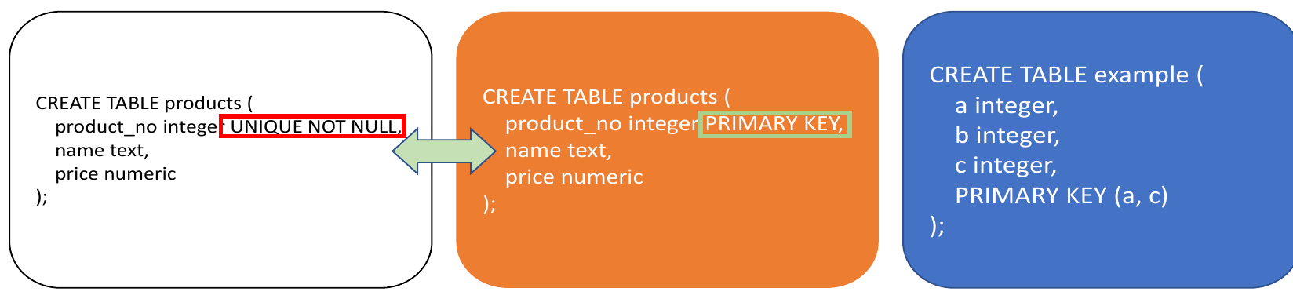
Restrictions: PRIMARY KEY
A table cannot have two records with the same key value.
A table can only have one primary key.

Slide 23
Restrictions: FOREIGN KEY
Foreign key - an attribute (or group of attributes) whose value can be repeated for several records.
Contains a reference to a primary key field in another table.
The table containing the foreign key is called a child table, containing the primary key - parent table.

Slide 24
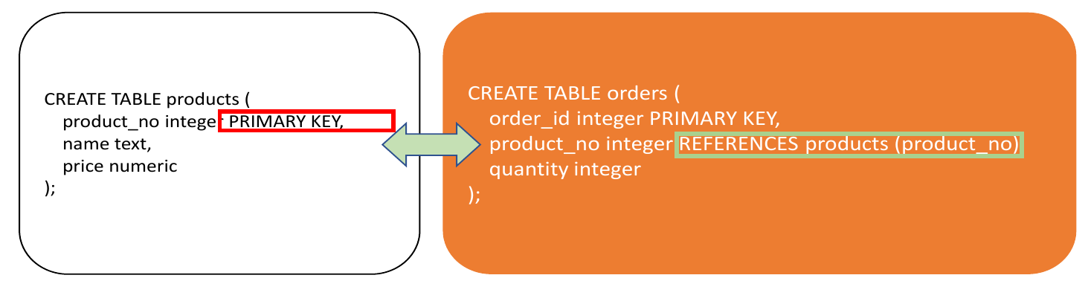
Restrictions: FOREIGN KEY

Slide 25
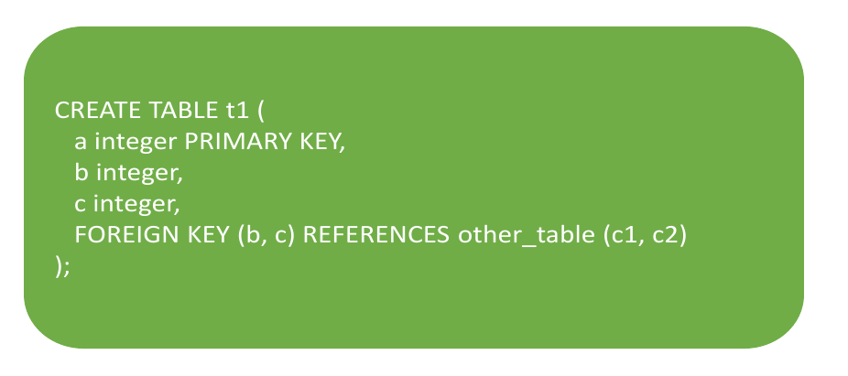
Restrictions: FOREIGN KEY
FOREIGN KEY can refer to a group of columns of the target relation:

Slide 26
Restrictions: CHECK
CHECK - sets an arbitrary condition on the values of one or several columns in one table row.
• The CHECK constraint specifies an expression that returns a logical result that determines whether the add or change operation is successful for specific lines:
• TRUE or UNKNOWN - operation completed successfully
• FALSE - an error occurs, the operation does not change anything in the database

Slide 27
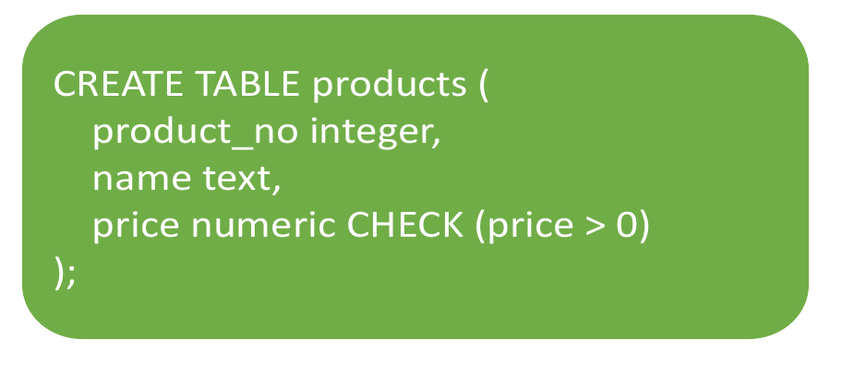
Restrictions: CHECK

Slide 28
Restrictions: DEFAULT
The value is specified by an expression without variables (in particular, cross-references to other columns of the current table are not allowed in it). Subqueries are also not allowed. The data type of the expression that specifies the default value must match the data type of the column.
This expression will be used in all data append operations that do not specify a value for this column. If a default value is not defined, the value will be NULL.

Slide 29
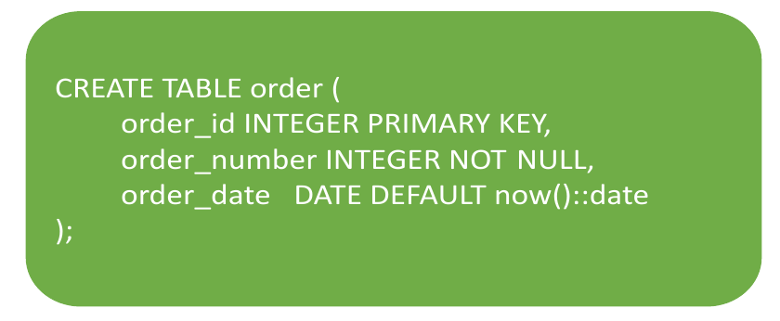
Restrictions: DEFAULT

Slide 30
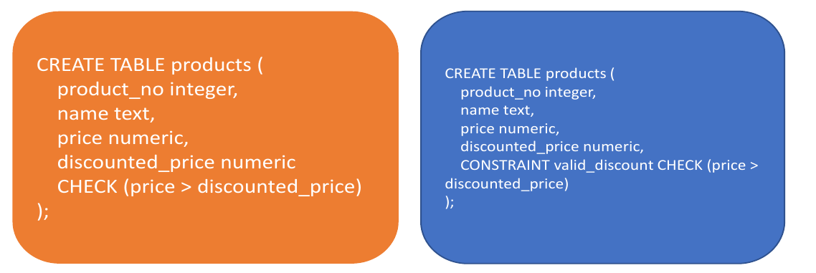
Restrictions syntax
Constraints can be named using the command CONSTRAINT (this is useful for error output)

Slide 31
Keys: potential key
A potential key is a subset of relation attributes in a relational data model that satisfies the following requirements:
• uniqueness - there are not and cannot be two tuples of a given relation in which the values of this subset of attributes coincide (are equal)
• irreducibility (minimality) - the potential key does not contain a smaller subset of attributes that satisfies the uniqueness condition. In other words, if any attribute is removed from a potential key, it will lose its uniqueness property
A candidate key always exists, even if it includes all the attributes of the relation (follows from the properties of the relations). There can be several potential keys.

Slide 32
Keys: primary key
Primary key (PRIMARY KEY) is such a potential key of a relationship that is selected as the “primary”
• Any potential key is suitable as a primary key
Alternate key(s) – all other potential keys of the relationship

Slide 33
Keys: natural key
• Natural key – a key based on an existing relation attribute
• Surrogate key – based on a special, technical attribute that has no meaningful meaning (id). Despite the obvious advantages (immutability, guaranteed uniqueness, efficiency, etc.), surrogate keys also have their disadvantages (lack of information, use instead of normalization, vulnerability of generators)

Slide 34
Keys: foreign key
To reflect the functional dependencies between tuples of different relations, duplication of the primary key of one relation (parent) to another (child) is used. Attributes that are copies of parent relationship keys are called foreign keys.
A foreign key in relation R2 is a non-empty subset FK of the set of attributes of this relation, such that:
1) There is a relation R1 with a potential key PK;
2) Each value of the foreign key FK in the current value of the relation R2 necessarily coincides with the value of the key PK of some tuple in the current value of the relation R1.
The relationships R1 and R2 are not necessarily different.

Slide 35
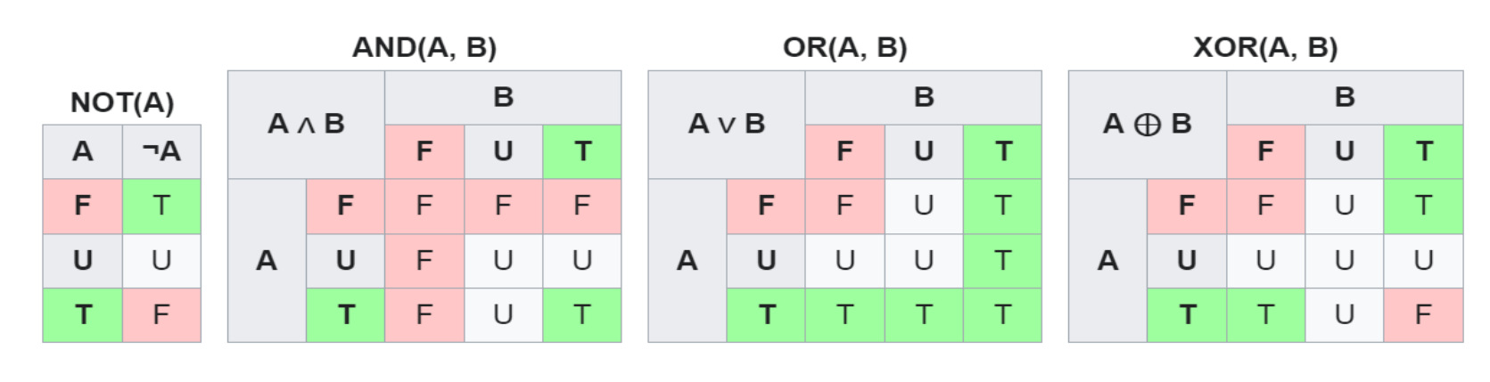
Ternary logic: True, False, Unknown

Slide 36
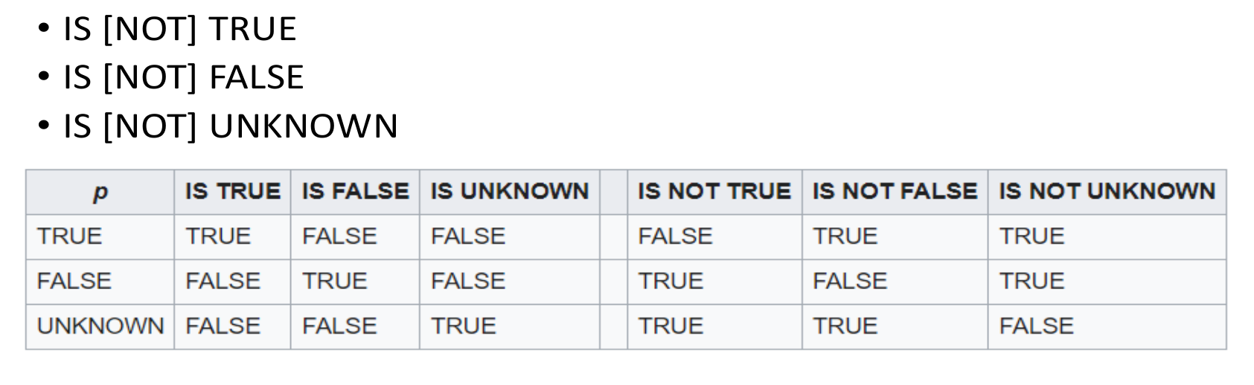
Ternary logic

Slide 37
Data Definition Language
ALTER - modification of objects
ALTER TABLE table_name ADD column_name datatype;
ALTER TABLE table_name DROP column_name;
ALTER TABLE table_name RENAME column_name TO new_column_name;
ALTER TABLE table_name ALTER column_name TYPE datatype;

Slide 38
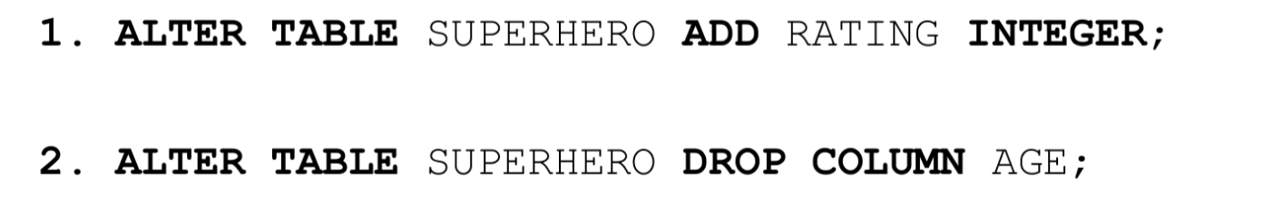
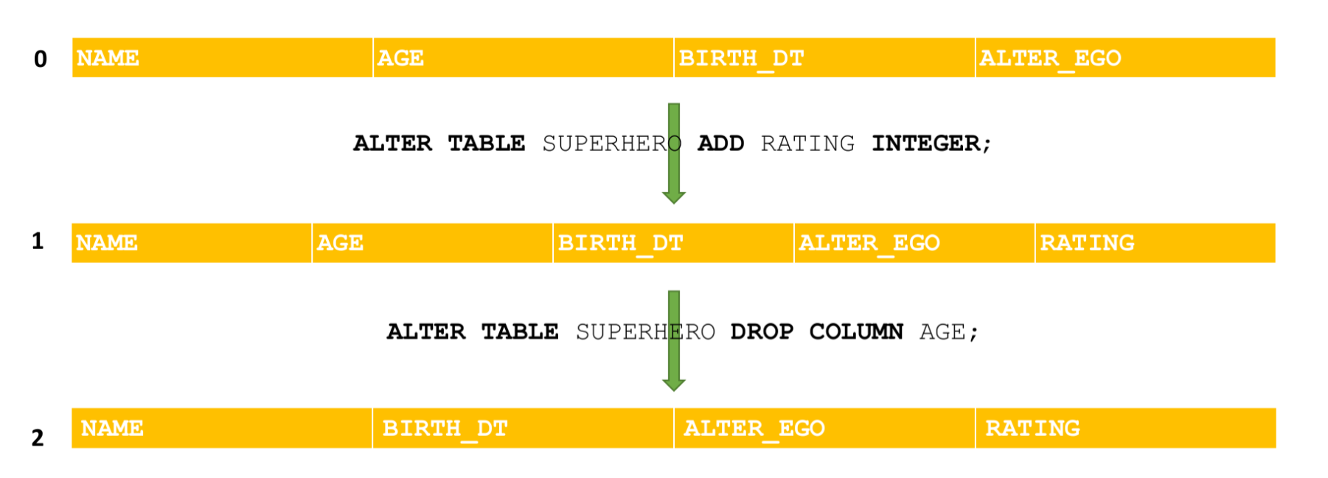
Alter

Slide 39

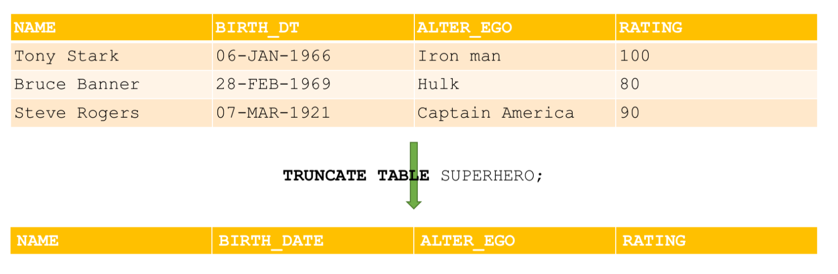
Data Definition Language
TRUNCATE – deleting the contents of the database object (data is deleted as a whole piece, cannot be deleted by condition)

Slide 40
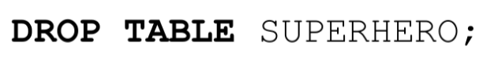

Drop
Deleting an object from the database

Slide 41
Data Manipulation Language
SELECT
Selection of data that meets the specified conditions
INSERT
Adding new data
UPDATE
Change existing data
DELETE
Delete existing data

Slide 42
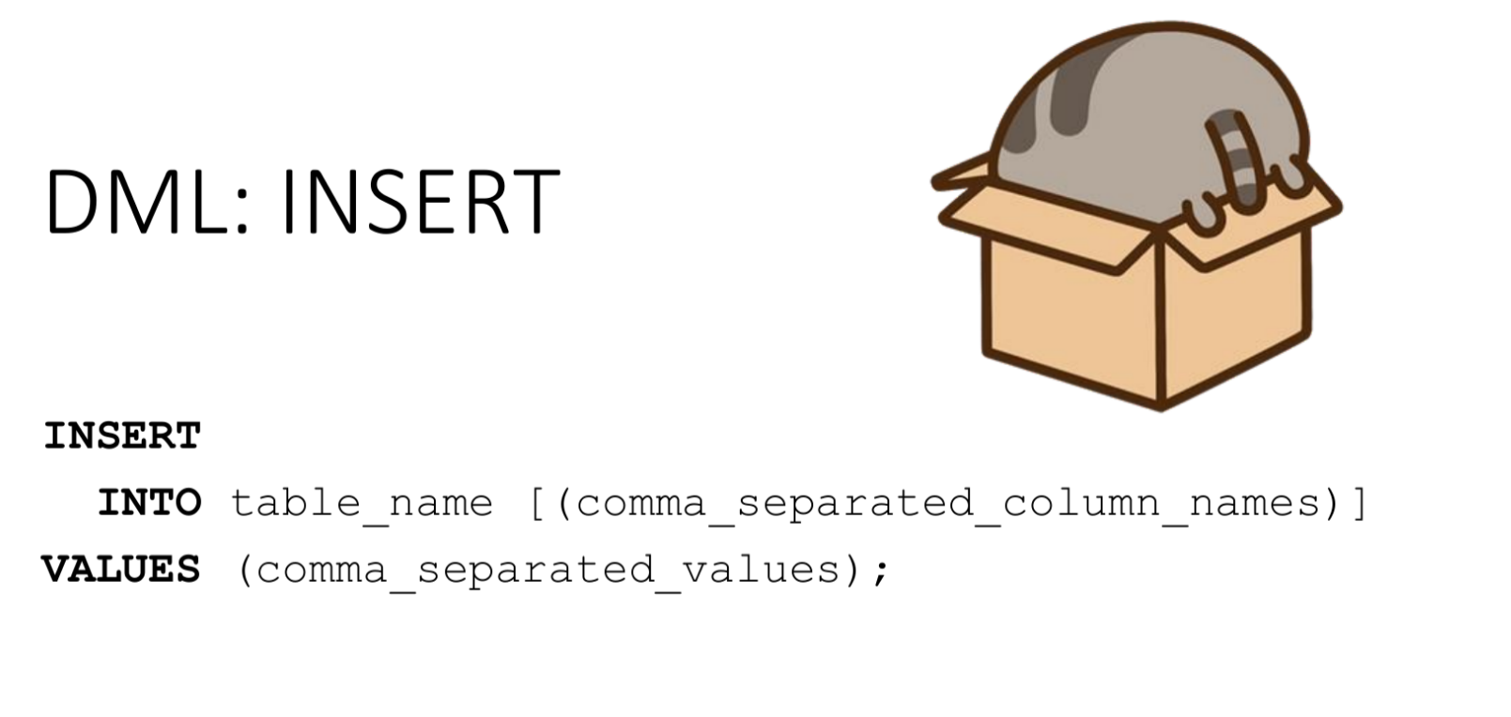

Slide 43
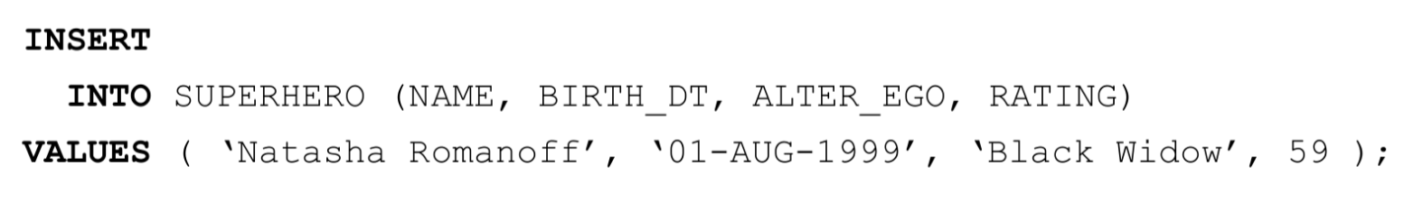
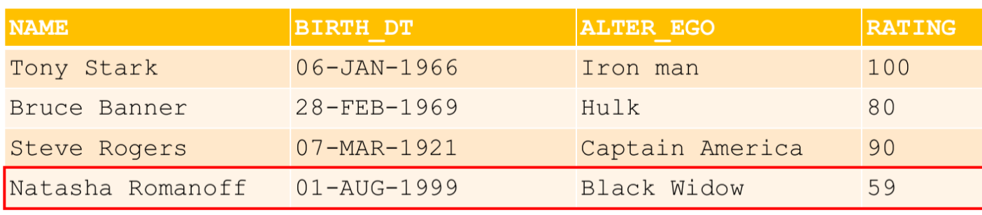
Insert

Slide 44
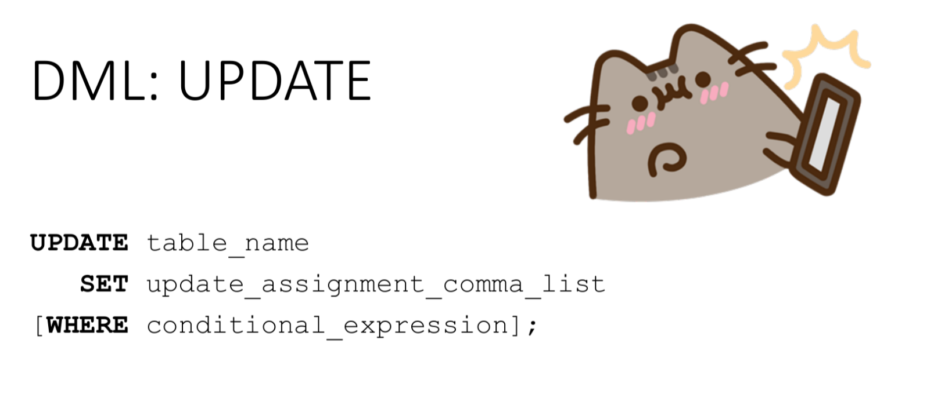

Slide 45
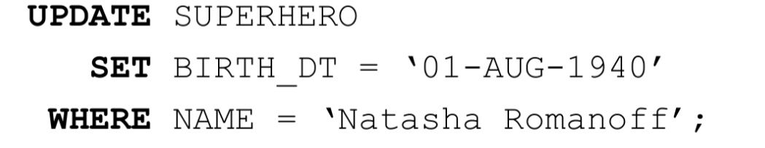
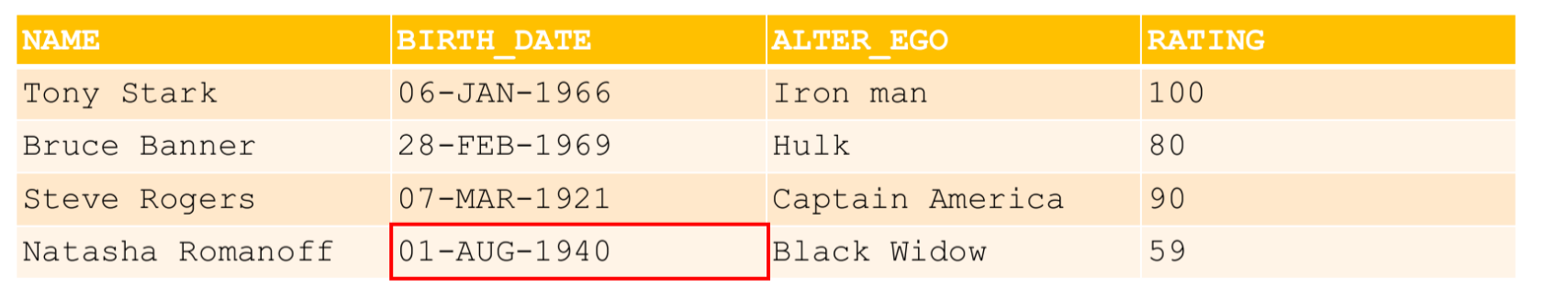
Update

Slide 46
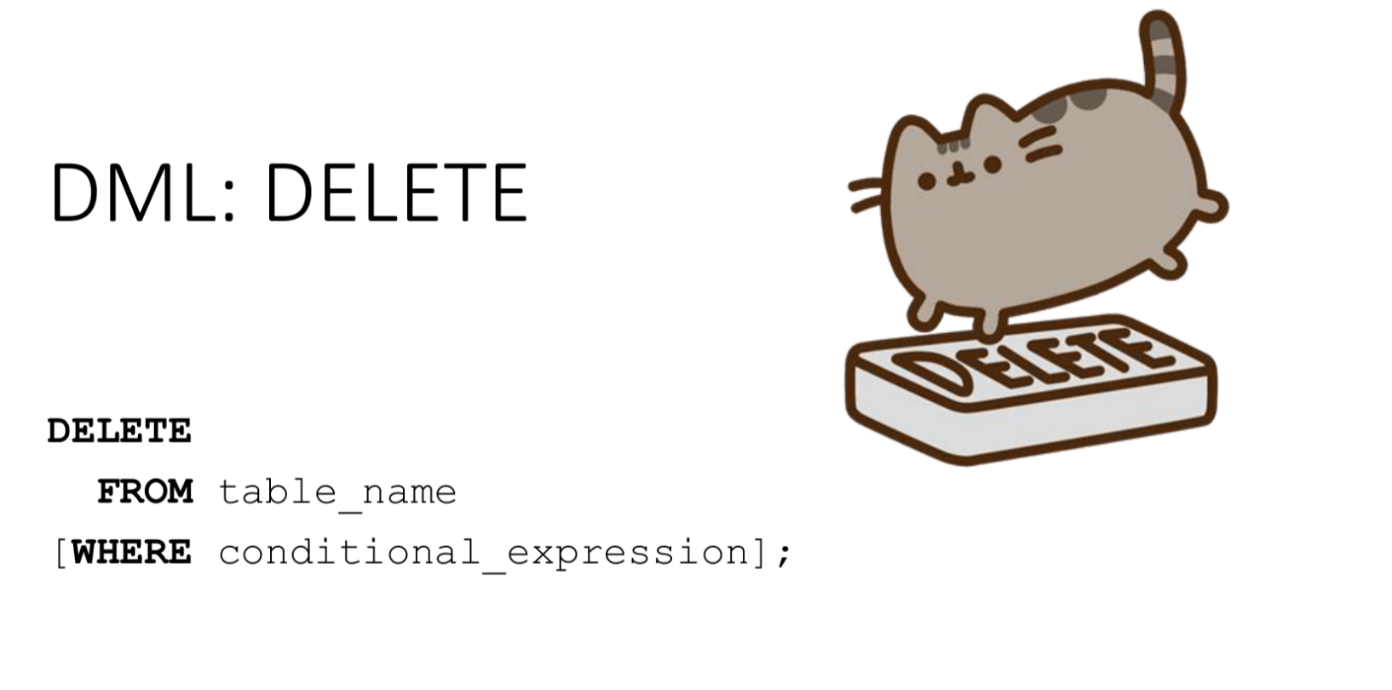

Slide 47
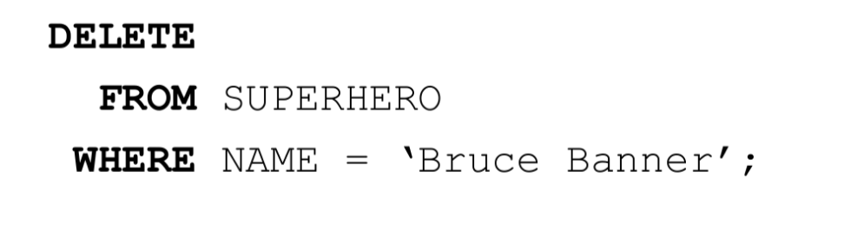
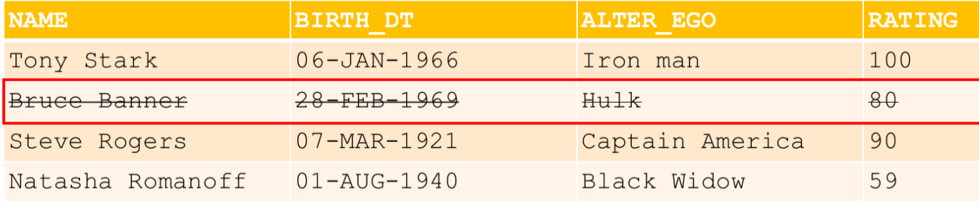
Delete

Slide 48
DML: DELETE vs DDL:TRUNCATE
Delete | Truncate
"Delete" line by line | Deleting the entire block at once
You can set conditions for deletion | Conditions for deletion cannot be set
Ability to roll back changes | There is no possibility of rolling back changes
Physically, the lines are not deleted, only marked "invisible" from a certain moment VACUUM is needed for removal | Deleting data and freeing up disk space occurs immediately

Slide 49
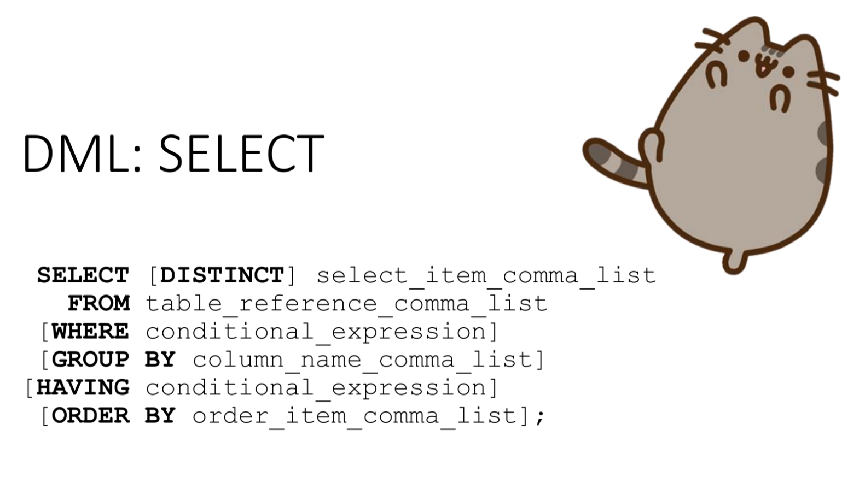

Slide 50
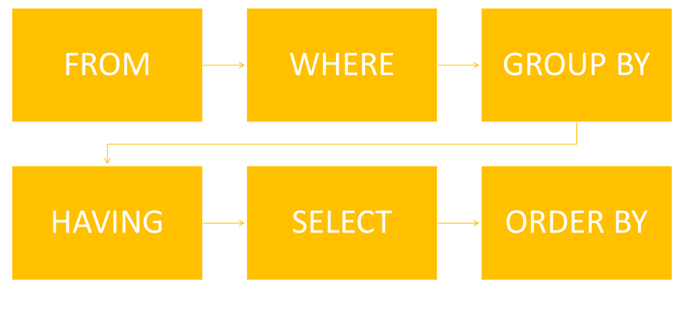
The order of execution of the request

Slide 51
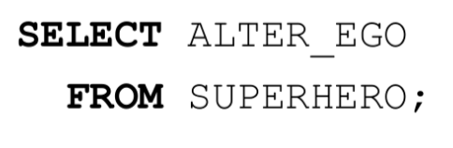
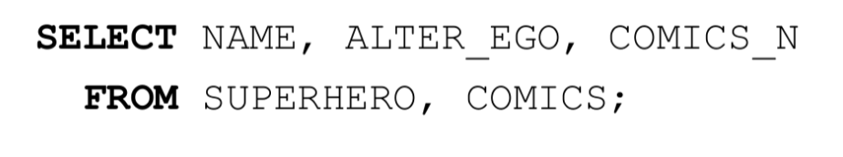
SELECT: FROM

Slide 52
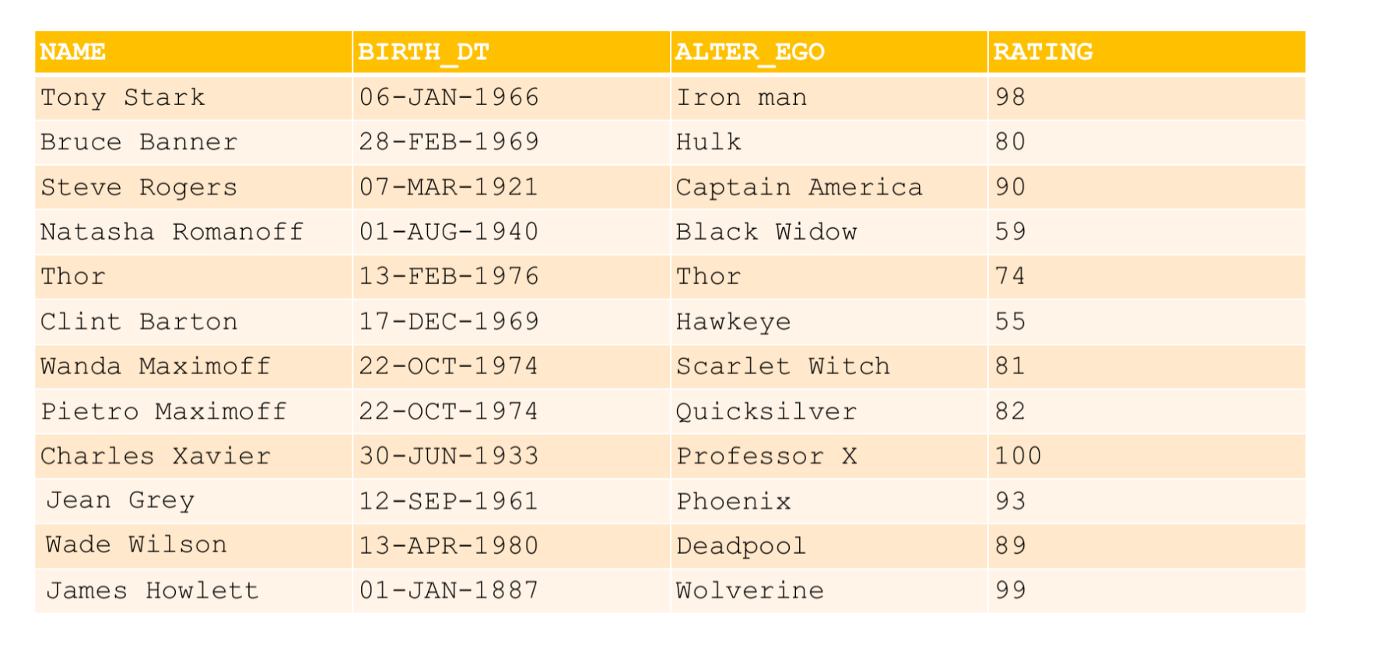

Slide 53
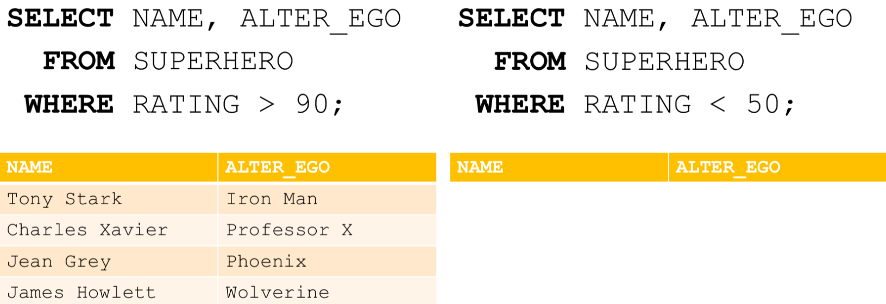
SELECT: WHERE

Slide 54
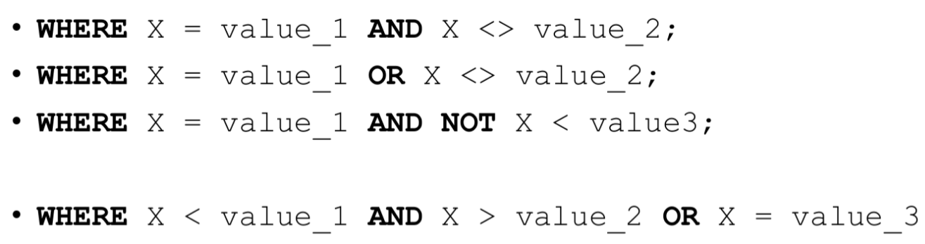
Where
priority: not, and, or

Slide 55
Useful functions
Sometimes it is useful to use special functions in a request:
IN - belonging to a certain set of values:
X IN (a1, a2, ..., an) ≣ X = a1 or X = a2 or ... or X = an
BETWEEN - belonging to a certain range of values:
X BETWEEN A AND B ≣ (X >= A and X <= B) or (X <= A and X >= B)
LIKE - satisfying the text pattern:
X LIKE '0%abc_0', where _ is exactly 1 character, and % is any sequence of characters (including zero length).

Slide 56
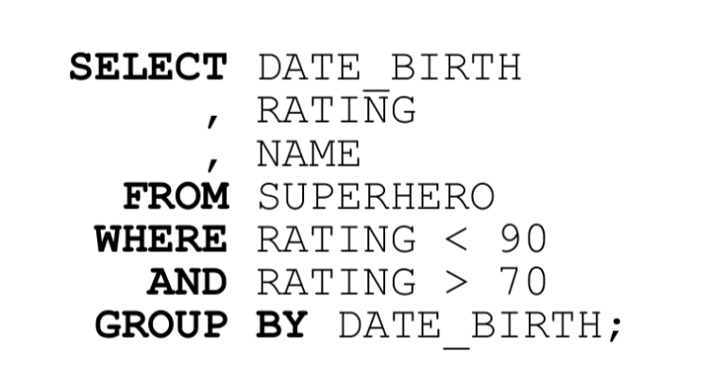
Why it would not work?

Slide 57
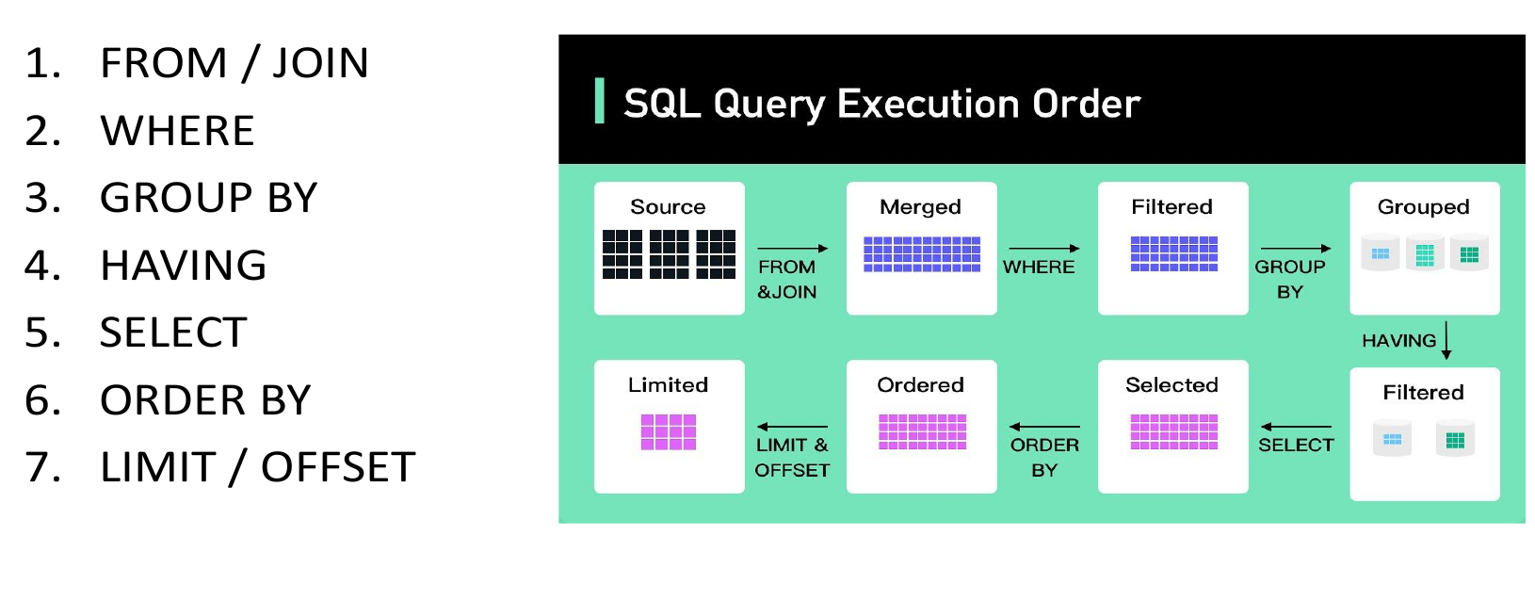
Steps

Slide 58
Aggregating functions
count() – the number of records with a known value. If you need to count the number of unique values, you can use count(DISTINCT field_nm)
max() - the largest of all selected field values
min() - the smallest of all selected field values
sum() - sum of all selected field values
avg() - average of all selected field values

Slide 59
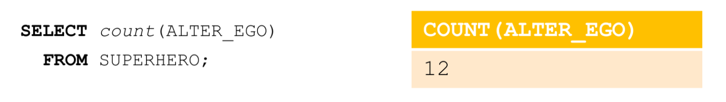
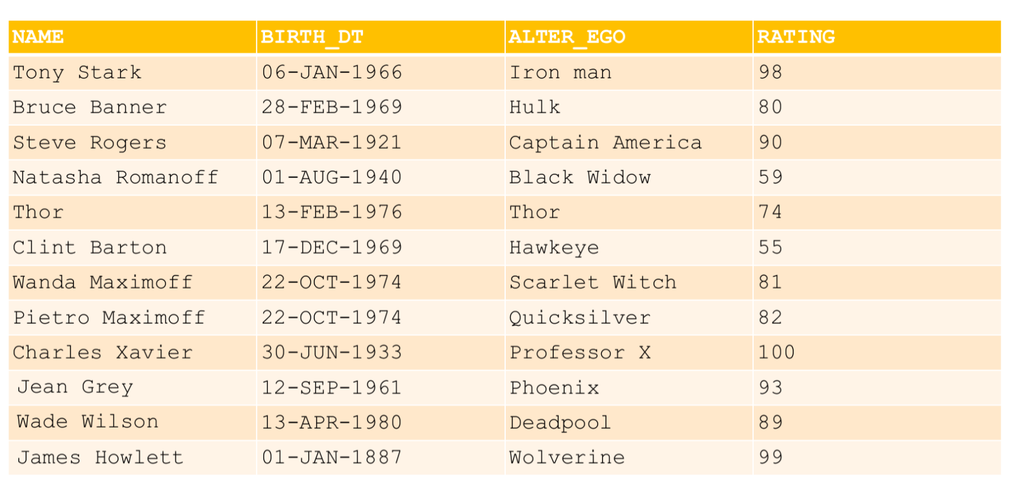
Count

Slide 60
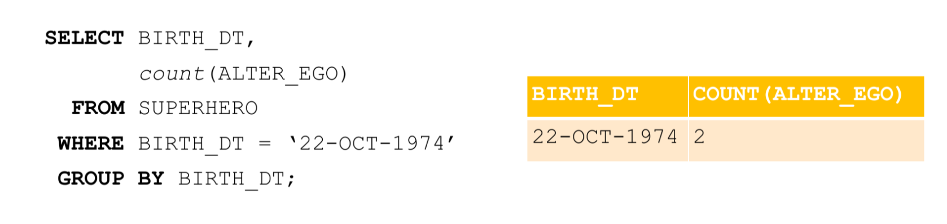
Group by

Slide 61
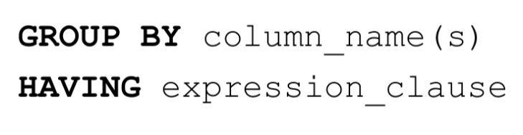
Having
It is used in conjunction with GROUP BY to impose restrictions on the selection after grouping
The restriction with the use of WHERE can be imposed only before grouping

Slide 62
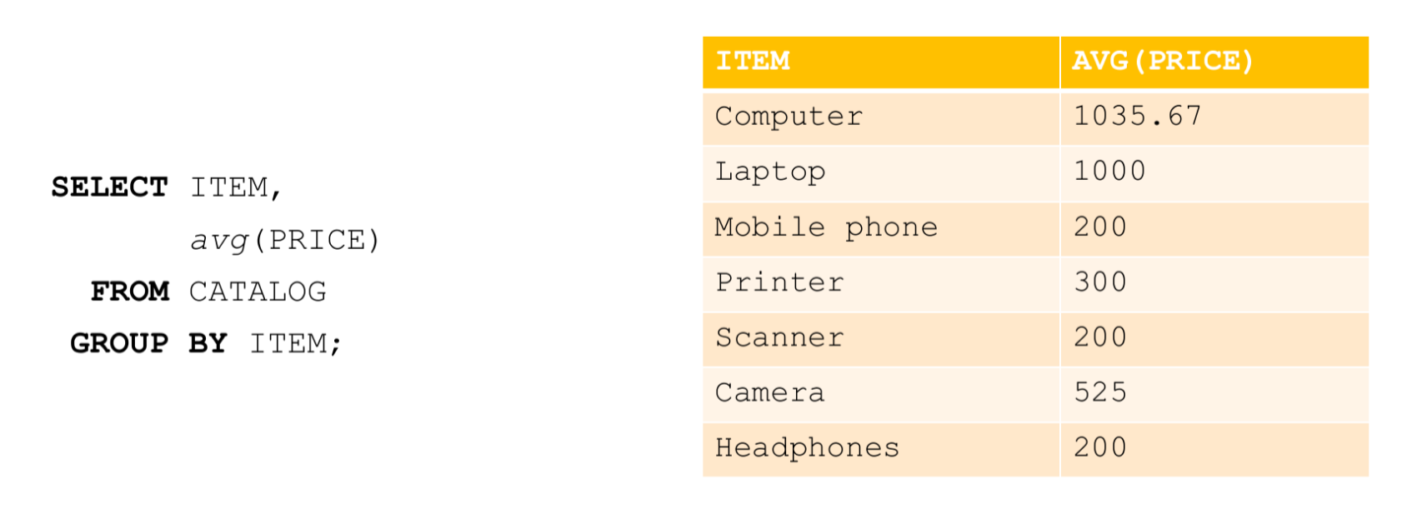

Slide 63
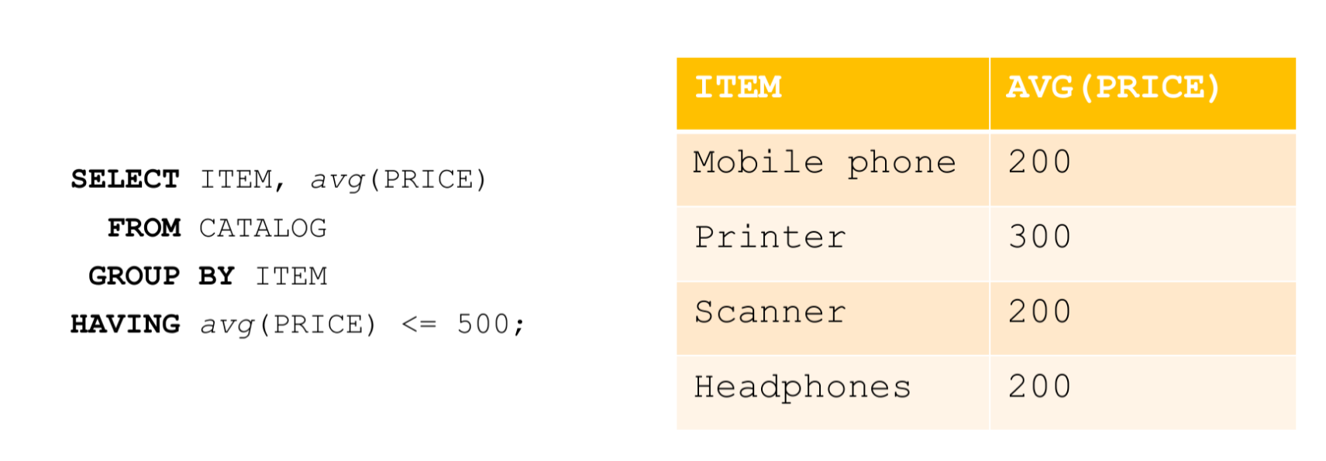

Slide 64
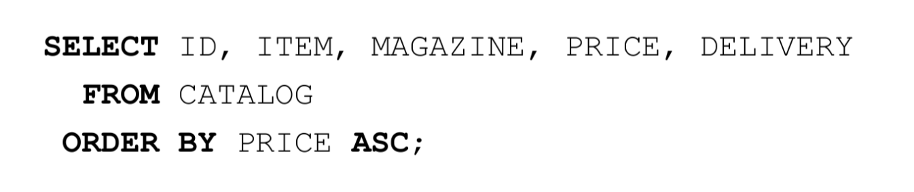
Order by
ASC – ascending
DESC – descending

Slide 65
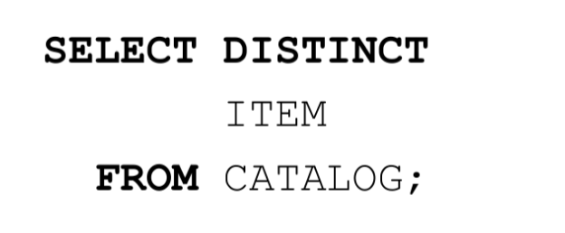
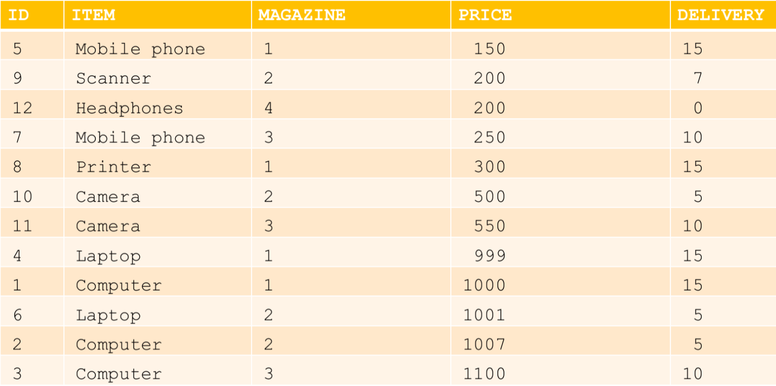
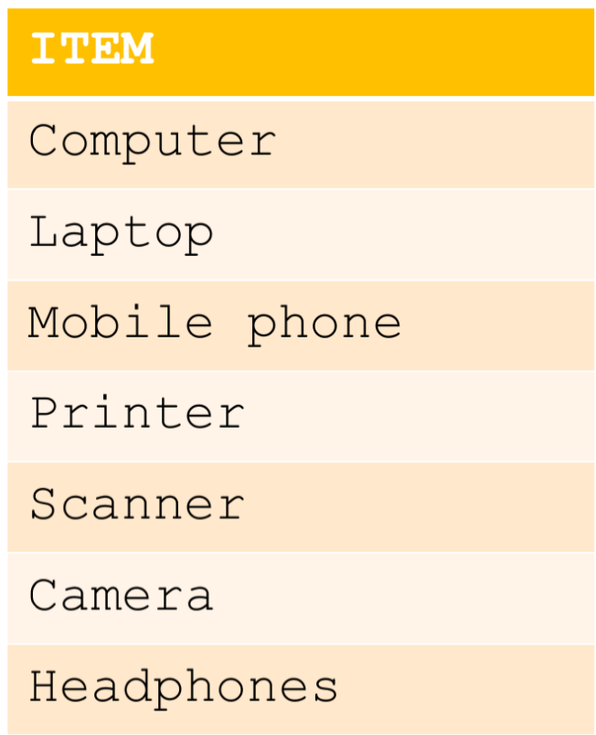
Distinct

Slide 66
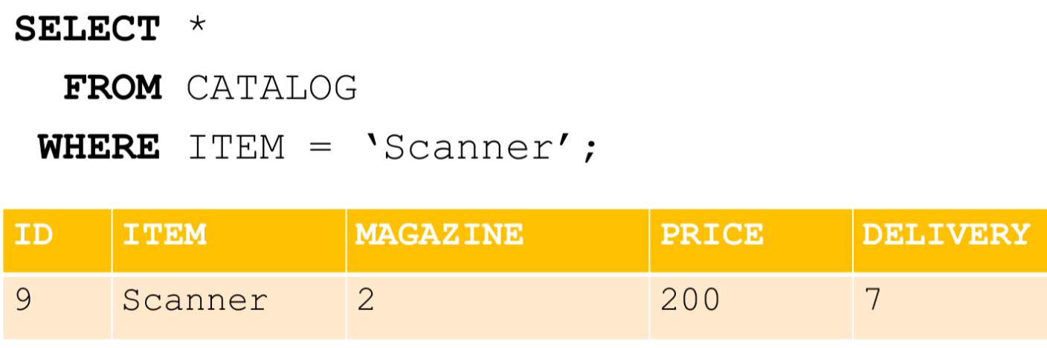
Select *

Slide 67

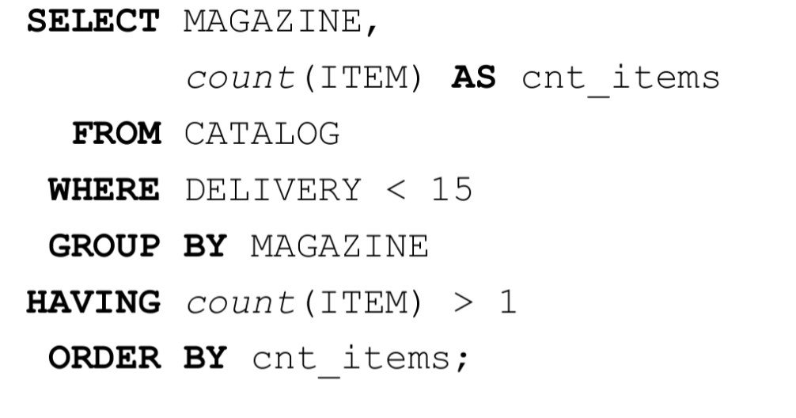
Select: alias

Slide 68
More aliases
Alias Column Syntax
SELECT column_name AS alias_name FROM table_name;
Alias Table Syntax
SELECT column_name(s) FROM table_name AS alias_name;

Slide 69
Relations between tables
one to one
one to many
many to many

Slide 70
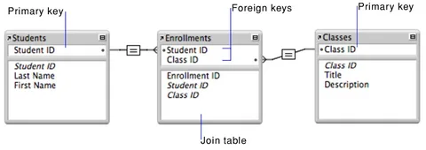
FOREIGN KEY

Slide 71
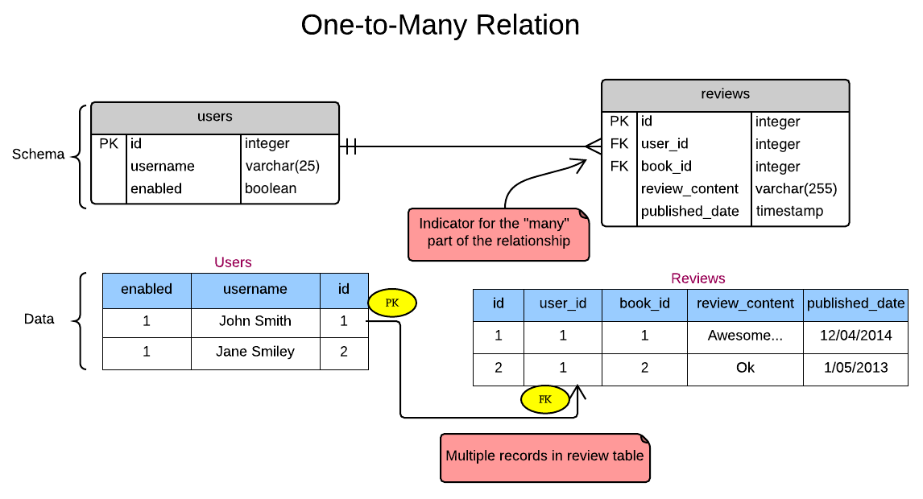
One-to-one

Slide 72
One-to-many

Slide 73
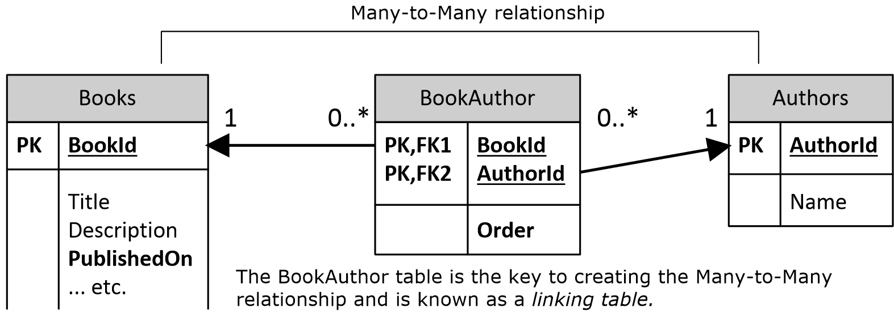
Many-to-many

Slide 74
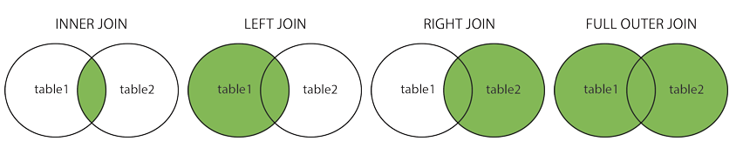
JOIN

Slide 75
INNER JOIN
INNER JOIN: Returns records that have matching values in both tables
INNER JOIN Syntax
SELECT column_name(s) FROM table1 INNER JOIN table2 ON table1.column_name = table2.column_name

Slide 76


Slide 77
LEFT JOIN
LEFT (OUTER) JOIN: Returns all records from the left table and matching records from the table on the right
LEFT JOIN Syntax
SELECT column_name(s) FROM table1 LEFT JOIN table2 ON table1.column_name = table2.column_name;

Slide 78


Slide 79
RIGHT JOIN
RIGHT (OUTER) JOIN: Returns all records from the table on the right, and matching records from the left table
RIGHT JOIN Syntax
SELECT column_name(s) FROM table1 RIGHT JOIN table2 ON table1.column_name = table2.column_name;

Slide 80


Slide 81
FULL JOIN
FULL (OUTER) JOIN: Returns all records when there is a match in the left or right table
FULL OUTER JOIN Syntax
SELECT column_name(s) FROM table1 FULL OUTER JOIN table2 ON table1.column_name = table2.column_name;

Slide 82


Slide 83
CROSS JOIN
CROSS JOIN = Cartesian product of two tables
SELECT column_name(s) FROM table1 CROSS JOIN table2

Slide 84


Slide 85

Subquery example

Slide 86
Subquery
Subqueries (also known as inner queries or nested queries) are a tool for performing operations in multiple steps. For example, if you wanted to take the sums of several columns, then average all of those values, you'd need to do each aggregation in a distinct step.

Slide 87
Subquery example 1
SELECT sub.*
FROM (
SELECT *
FROM tutorial.sf_crime_incidents_2014_01
WHERE day_of_week = 'Friday'
) sub
WHERE sub.resolution = 'NONE'

Slide 88
Subquery example 2
SELECT *
FROM tutorial.sf_crime_incidents_2014_01
WHERE Date = (SELECT MIN(date)
FROM tutorial.sf_crime_incidents_2014_01
)

Slide 89
Subquery example 3
SELECT *
FROM tutorial.sf_crime_incidents_2014_01
WHERE Date IN (SELECT date
FROM tutorial.sf_crime_incidents_2014_01
ORDER BY date
LIMIT 5
)

Slide 90
Subquery example 4
SELECT incidents.*, sub.incidents AS incidents_that_day
FROM tutorial.sf_crime_incidents_2014_01 incidents
JOIN ( SELECT date, COUNT(incidnt_num) AS incidents
FROM tutorial.sf_crime_incidents_2014_01
GROUP BY 1 ) sub
ON incidents.date = sub.date
ORDER BY sub.incidents DESC, time

Slide 91
UNIONS
SQL has strict rules for appending data:
Both tables must have the same number of columns
The columns must have the same data types in the same order as the first table
SELECT *
FROM tutorial.crunchbase_investments_part1
UNION ALL
SELECT *
FROM tutorial.crunchbase_investments_part2;

